Slide 1


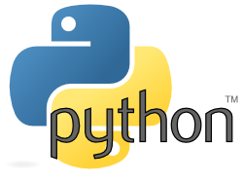
Computational Thinking and Programming
python
Sami tech

Slide 2

Using python
SELECTION
SEQUENCE
ITERATION

Slide 3
LEARNING OUTCOMES
After studying this lesson, students will be able to:
Understand the concept and usage of selection and iteration statements.
Know various types of loops available in Python.
Analyze the problem, decide and evaluate conditions.

Slide 4
LEARNING OUTCOMES
After studying this lesson, students will be able to:
Will be able to analyze and decide for an appropriate combination of constructs.
Write code that employ decision structures, including those that employ sequences of decision and nested decisions.
Design simple applications having iterative nature.

Slide 5
INTRODUCTION

Slide 6
INTRODUCTION
Programs are written for the solution to the real world problems. A language should have the ability to control the flow of execution so that at different intervals different statements can be executed. Structured programming is a paradigm aims at controlling the flow of execution of statements in a program by using control structures.
A language which supports the control structures is called as structured programming language

Slide 7
INTRODUCTION
Programs are written for the solution to the real world problems. A language should have the ability to control the flow of execution so that at different intervals different statements can be executed. Structured programming is a paradigm aims at controlling the flow of execution of statements in a program by using control structures.
A language which supports the control structures is called as structured programming language

Slide 8
Python is a very popular general-purpose interpreted, interactive, object-oriented, and high-level programming language Python is a high-level programming language which is: -Interpreted :- Python is process at runtime by the interpreter. -Interactive :- You can use a python prompt & interact with the interpreter directly to write your program.
What is Python?
Object-oriented :- Python supports Object-oriented technique of programming. python is a great language for the beginner-level programmers & supports the development of a wide range of applications.

Slide 9
Today a Python Programmer with 3-5 years of experience is asking for around $150,000 annual package and this is the most demanding programming language in America. Though it can vary depending on the location of the Job. It's impossible to list all of the companies using Python, to name a few big companies are:
IBM
Amazon
Netflix
Pinterest
Uber
Many more...
Google
Intel
NASA
PayPal
Facebook

Slide 10
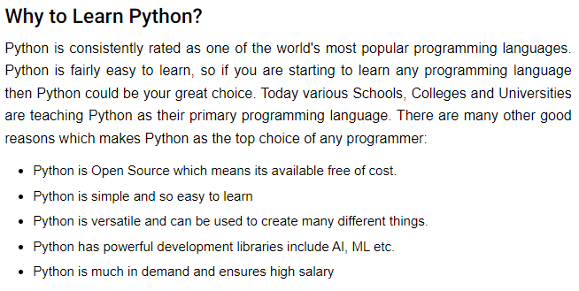

Slide 11
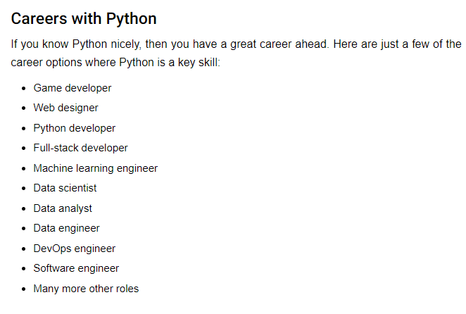

Slide 12
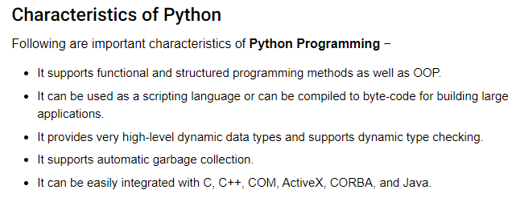

Slide 13
Applications of Python
The latest release of Python is 3.x. As mentioned before, Python is one of the most widely used language over the web. I'm going to list few of them here:
Easy-to-learn − Python has few keywords, simple structure, and a clearly defined syntax. This allows the student to pick up the language quickly.
Easy-to-read − Python code is more clearly defined and visible to the eyes.
Easy-to-maintain − Python's source code is fairly easy-to-maintain.
A broad standard library − Python's bulk of the library is very portable and cross-platform compatible on UNIX, Windows, and Macintosh.
Interactive Mode − Python has support for an interactive mode which allows interactive testing and debugging of snippets of code.
Portable − Python can run on a wide variety of hardware platforms and has the same interface on all platforms.
Extendable − You can add low-level modules to the Python interpreter. These modules enable programmers to add to or customize their tools to be more efficient.
Databases − Python provides interfaces to all major commercial databases.
GUI Programming − Python supports GUI applications that can be created and ported to many system calls, libraries and windows systems, such as Windows MFC, Macintosh, and the X Window system of Unix.

Slide 14
Easy to learn, easy to read & easy to maintain. Portable :- It can run on various hardware platform & has the same interface on all platform. Extensible :- You can add low-level modules to the python interpreter. Scalable :- Python provides a good structure and support for large programs. Python has support for an interactive mode of testing and debugging. Everything in python is an object.
Python Features:-

Slide 15
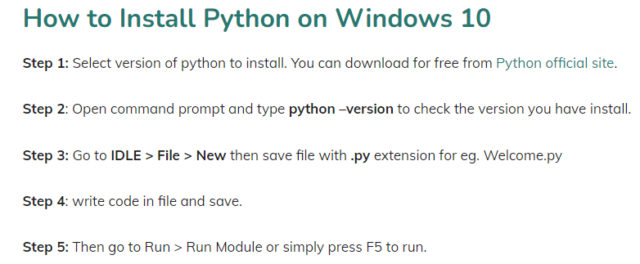

Slide 16
Python Identifiers
A Python identifier is a name used to identify a variable, function, class, module or other object. An identifier starts with a letter A to Z or a to z or an underscore (_) followed by zero or more letters, underscores and digits (0 to 9).
Python does not allow punctuation characters such as @, $, and % within identifiers. Python is a case sensitive programming language. Thus, Manpower and manpower are two different identifiers in Python.

Slide 17
Here are naming conventions for Python identifiers
Class names start with an uppercase letter. All other identifiers start with a lowercase letter.
Starting an identifier with a single leading underscore indicates that the identifier is private.
Starting an identifier with two leading underscores indicates a strongly private identifier.
If the identifier also ends with two trailing underscores, the identifier is a language-defined special name.

Slide 18
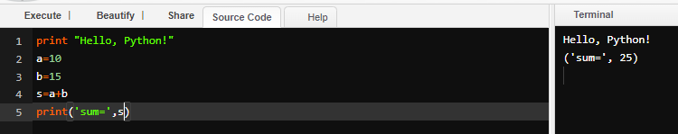
Python - Variable Types
Variables are nothing but reserved memory locations to store values. This means that when you create a variable you reserve some space in memory.
Based on the data type of a variable, the interpreter allocates memory and decides what can be stored in the reserved memory. Therefore, by assigning different data types to variables, you can store integers, decimals or characters in these variables.
Assigning Values to Variables
Python variables do not need explicit declaration to reserve memory space. The declaration happens automatically when you assign a value to a variable. The equal sign (=) is used to assign values to variables.
The operand to the left of the = operator is the name of the variable and the operand to the right of the = operator is the value stored in the variable. For example −

Slide 19
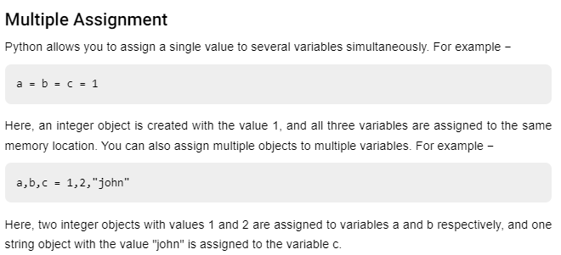

Slide 20
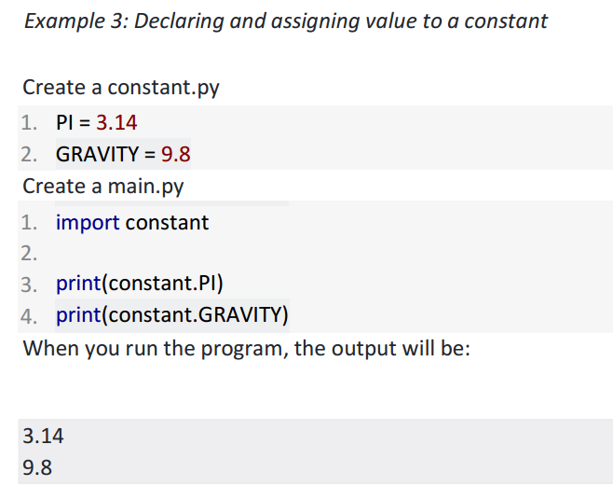
Assigning value to a constant in Python
In Python, constants are usually declared and assigned on a module. Here, the module means a
new file containing variables, functions etc which is imported to main file. Inside the module,
constants are written in all capital letters and underscores separating the words.

Slide 21
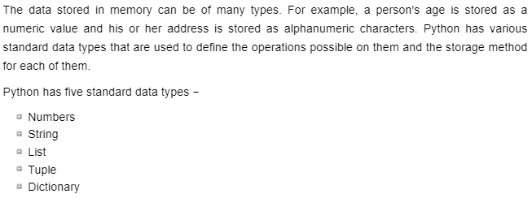
Standard Data Types python

Slide 22
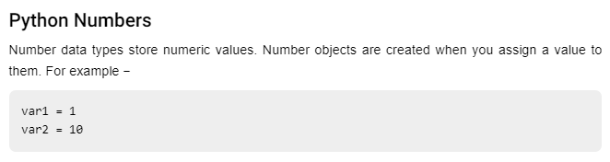
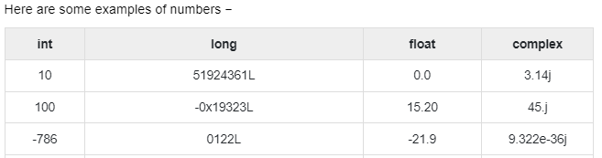

Slide 23
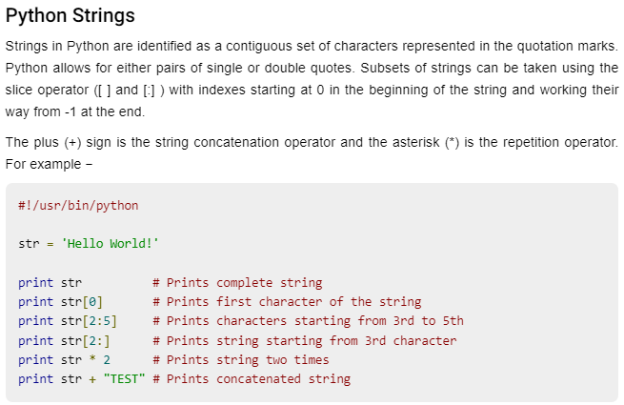

Slide 24
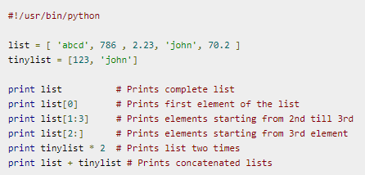
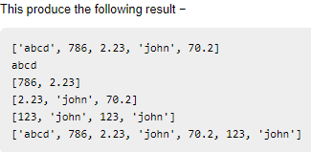
Python Lists
Lists are the most versatile of Python's compound data types. A list contains items separated by commas and enclosed within square brackets ([]). To some extent, lists are similar to arrays in C. One difference between them is that all the items belonging to a list can be of different data type.
The values stored in a list can be accessed using the slice operator ([ ] and [:]) with indexes starting at 0 in the beginning of the list and working their way to end -1. The plus (+) sign is the list concatenation operator, and the asterisk (*) is the repetition operator. For example −

Slide 25
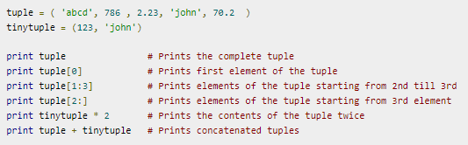
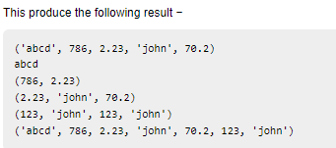
Python Tuples
A tuple is another sequence data type that is similar to the list. A tuple consists of a number of values separated by commas. Unlike lists, however, tuples are enclosed within parentheses.
The main differences between lists and tuples are: Lists are enclosed in brackets ( [ ] ) and their elements and size can be changed, while tuples are enclosed in parentheses ( ( ) ) and cannot be updated. Tuples can be thought of as read-only lists. For example −

Slide 26
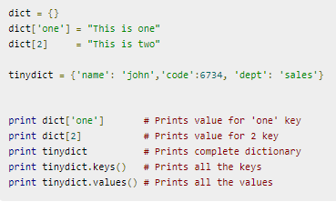
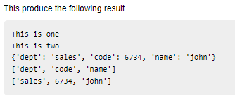
Python Dictionary
Python's dictionaries are kind of hash table type. They work like associative arrays or hashes found in Perl and consist of key-value pairs. A dictionary key can be almost any Python type, but are usually numbers or strings. Values, on the other hand, can be any arbitrary Python object.
Dictionaries are enclosed by curly braces ({ }) and values can be assigned and accessed using square braces ([]). For example −

Slide 27
Data Type Conversion
Sometimes, you may need to perform conversions between the built-in types. To convert between types, you simply use the type name as a function.
There are several built-in functions to perform conversion from one data type to another. These functions return a new object representing the converted value.
Sr.No. | Function & Description
1 | int(x [,base]) Converts x to an integer. base specifies the base if x is a string.
2 | tuple(s) Converts s to a tuple
3 | float(x) Converts x to a floating-point number.
4 | complex(real [,imag]) Creates a complex number. Complex number = Real and imaginary number
5 | str(x) Converts object x to a string representation.
6 | repr(x) Converts object x to an expression string.

Slide 28
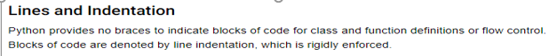
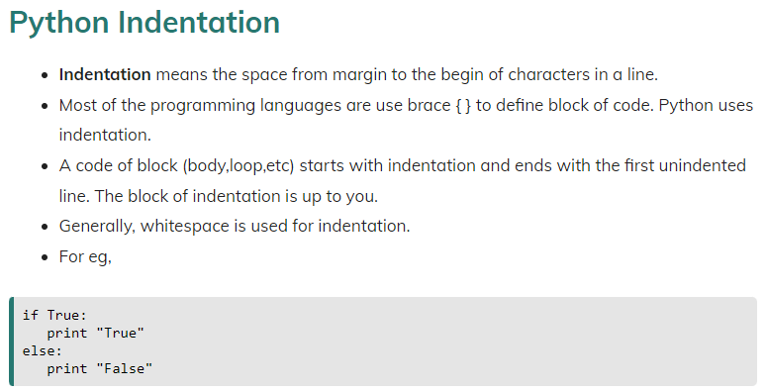
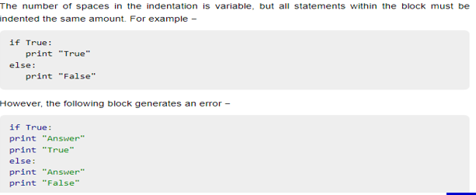

Slide 29
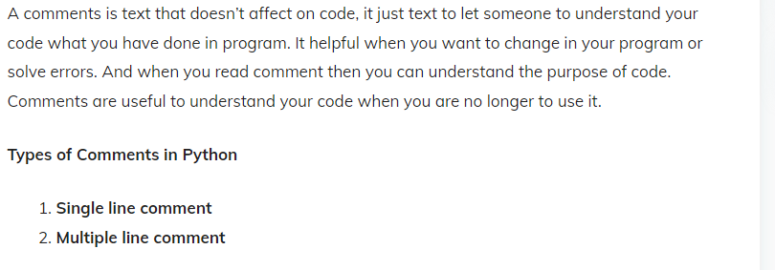

Slide 30
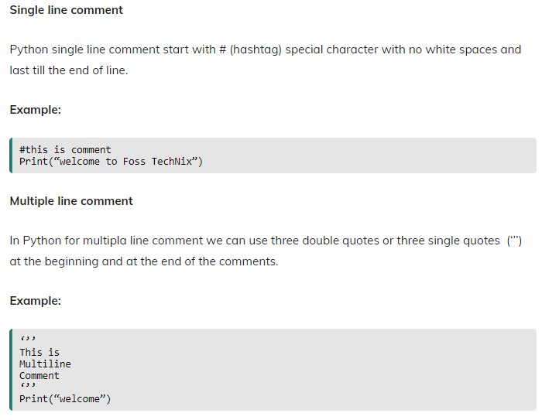
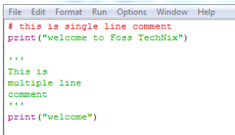

Slide 31
Using Blank Lines
A line containing only whitespace, possibly with a comment, is known as a blank line and Python totally ignores it.
In an interactive interpreter session, you must enter an empty physical line to terminate a multiline statement.
Multiple Statements on a Single Line
The semicolon ( ; ) allows multiple statements on the single line given that neither statement starts a new code block.
Here is a sample snip using the semicolon −
import sys; x = 'foo'; sys.stdout.write(x + '\n')

Slide 32
Types of Operator
Python language supports the following types of operators.
Arithmetic Operators
Comparison (Relational) Operators
Assignment Operators
Logical Operators
Bitwise Operators
Membership Operators
Identity Operators

Slide 33
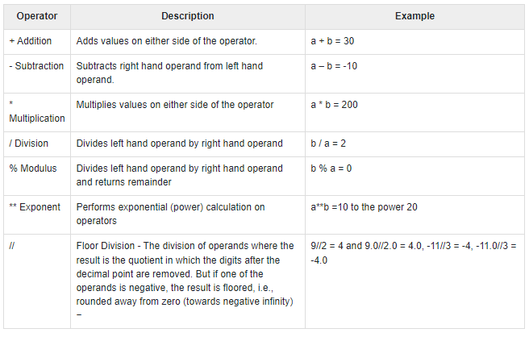
Python Arithmetic Operators
Assume variable a holds 10 and variable b holds 20, then

Slide 34
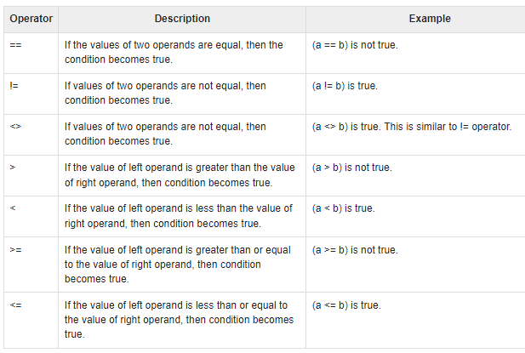
Python Comparison Operators
These operators compare the values on either sides of them and decide the relation among them. They are also called Relational operators.
Assume variable a holds 10 and variable b holds 20, then

Slide 35
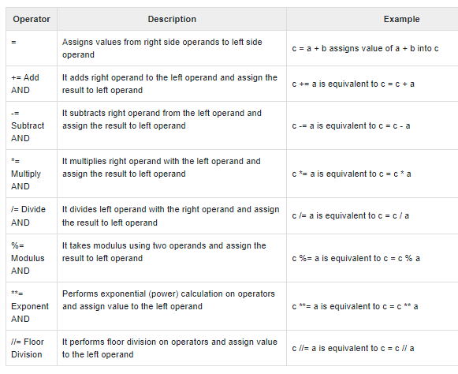
Python Assignment Operators
Assume variable a holds 10 and variable b holds 20, then −

Slide 36
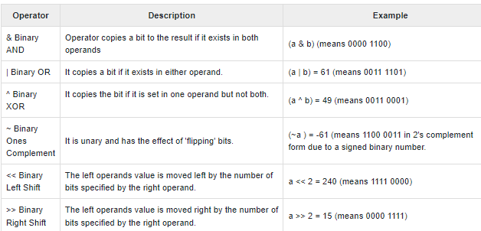
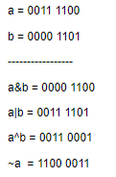
Python Bitwise Operators
Bitwise operator works on bits and performs bit by bit operation. Assume if a = 60; and b = 13; Now in the binary format their values will be 0011 1100 and 0000 1101 respectively. Following table lists out the bitwise operators supported by Python language with an example each in those, we use the above two variables (a and b) as operands −

Slide 37
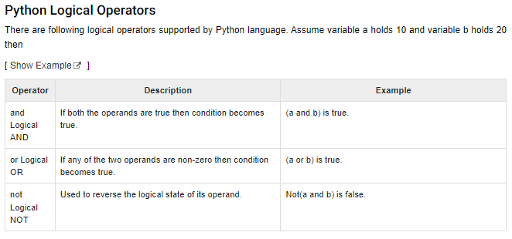

Slide 38
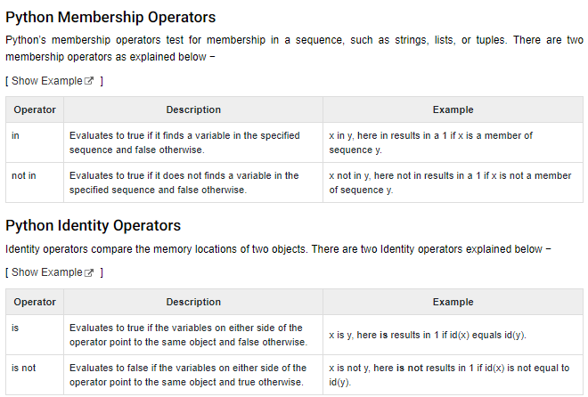

Slide 39
TYPES OF CONTROL STRUCTURES
Python - Decision Making

Slide 40
TYPES OF CONTROL STRUCTURES
A Structured programming is an important feature of a programming language which comprises following logical structure:
1. SEQUENCE
2. SELECTION
3. ITERATION OR LOOPING
4. BRANCHING OR JUMPING STATEMENTS

Slide 41
1. SEQUENCE
Sequence is the default control structure; instructions are executed one after another.
Statement 1
Statement 2
Statement 3
……..
……..
……..

Slide 42
1. SEQUENCE – FLOW CHART

Slide 43
1. SEQUENCE – FLOW CHART
Statement 1
Statement 2
Statement 3
SEQUENCE

Slide 44
1. SEQUENCE - PROGRAM

Slide 45
1. SEQUENCE - PROGRAM
Sequence is the default control structure; instructions are executed one after another.
# This program adds two numbers
def sum_of_two_no():
num1 = 1.5
num2 = 6.3
sum = float(num1) + float(num2)
print('The sum is =‘, sum)
sum_of_two_no():

Slide 46
2. SELECTION
SELECTION

Slide 47
2. SELECTION
A selection statement causes the program control to be transferred to a specific flow based upon whether a certain condition is true or not.

Slide 48
CONDITIONAL CONSTRUCT – if else STATEMENT

Slide 49
CONDITIONAL CONSTRUCT – if else STATEMENT
Conditional constructs (also known as if statements) provide a way to execute a chosen block of code based on the run-time evaluation of one or more Boolean expressions. In Python, the most general form of a conditional is written as follows:
Contd.. Next Slide

Slide 50
CONDITIONAL CONSTRUCT – if else STATEMENT
: Colon Must
if first condition:
first body
elif second condition:
second body
elif third condition:
third body
else:
fourth body

Slide 51
CONDITIONAL CONSTRUCT – if else STATEMENT
FLOW CHART

Slide 52
CONDITIONAL CONSTRUCT – if else STATEMENT
FLOW CHART
Condition ?
False
Statement 1
Statement 2
Main Body
True
Statement 1
else body
Statement 2

Slide 53
CONDITIONAL CONSTRUCT – if else STATEMENT
Each condition is a Boolean expression, and each body contains one or more commands that are to be executed conditionally.
If the first condition succeeds, the first body will be executed; no other conditions or bodies are evaluated in that case.

Slide 54
CONDITIONAL CONSTRUCT – if else STATEMENT
If the first condition fails, then the process continues in similar manner with the evaluation of the second condition. The execution of this overall construct will cause precisely one of the bodies to be executed.
There may be any number of elif clauses (including zero), and
The final else clause is optional.

Slide 55
CONDITIONAL CONSTRUCT – if else STATEMENT
EXAMPLE - PROGRAM

Slide 56
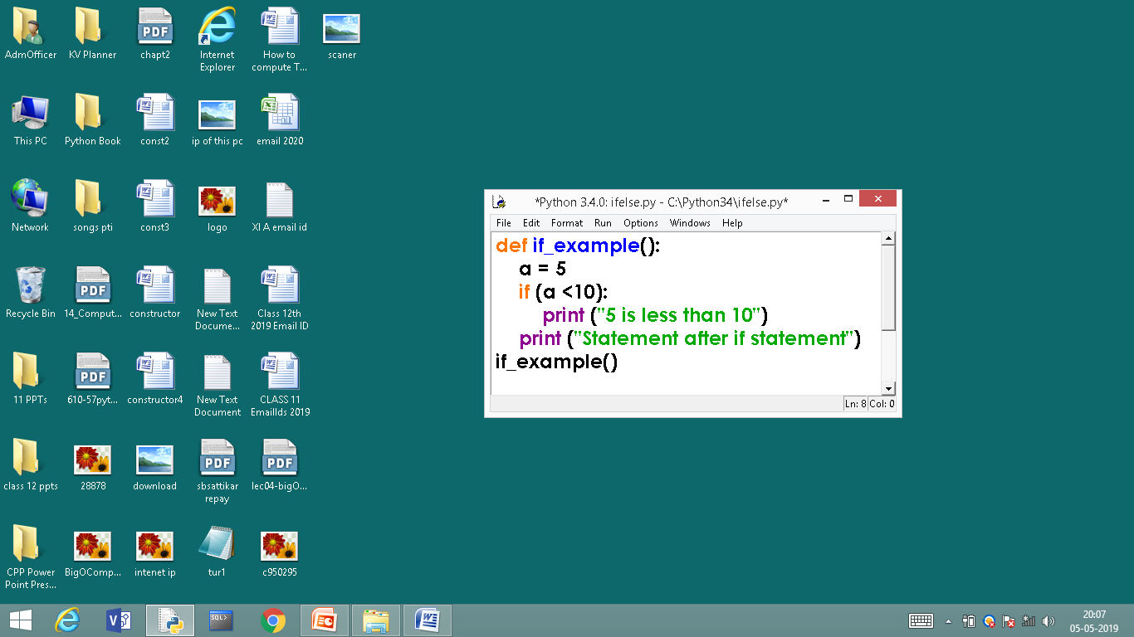
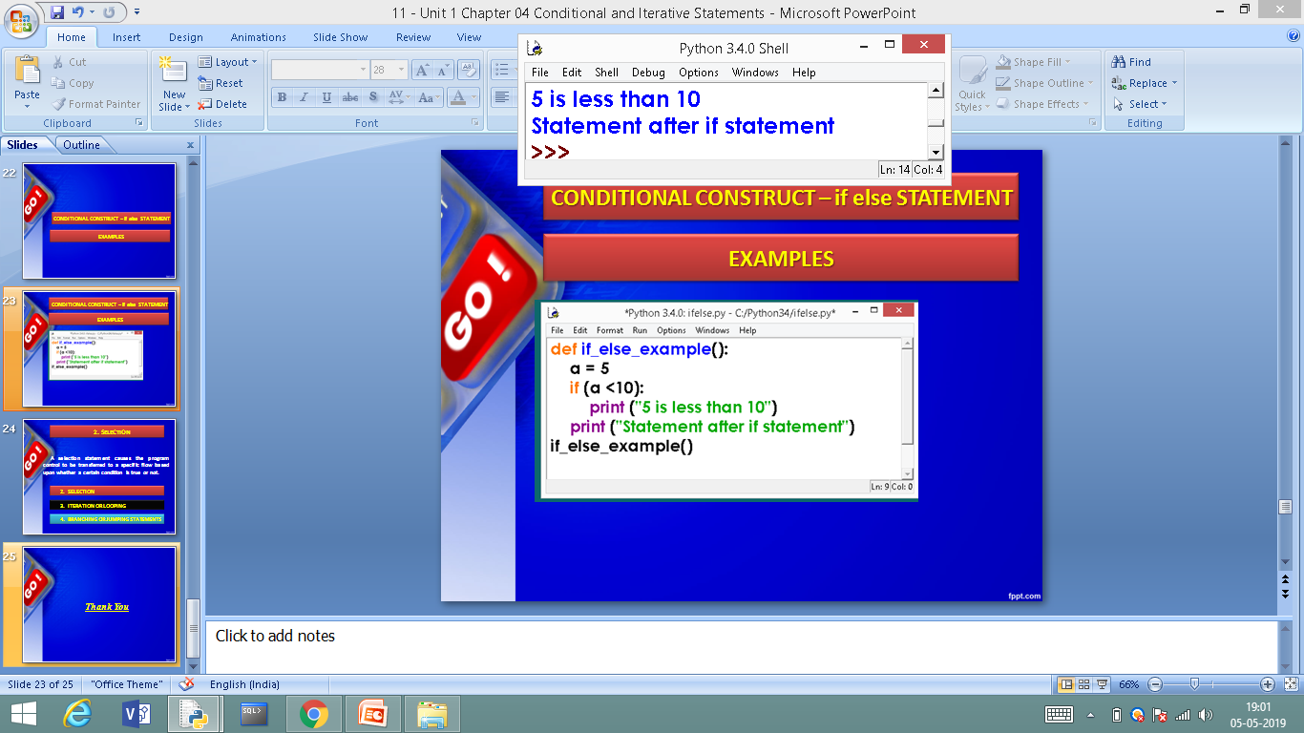
EXAMPLES – if STATEMENT
else is missing, it is an optional statement
OUT PUT

Slide 57
CONDITIONAL CONSTRUCT
EXAMPLE – if else STATEMENT

Slide 58
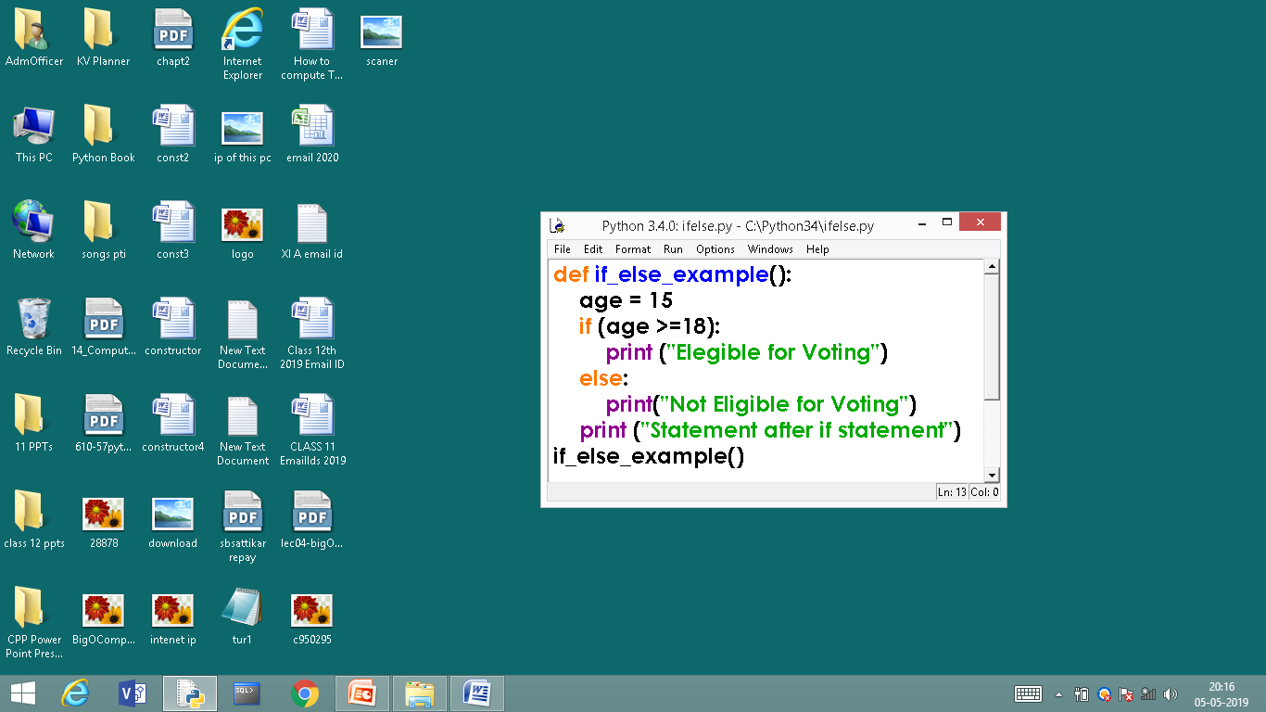
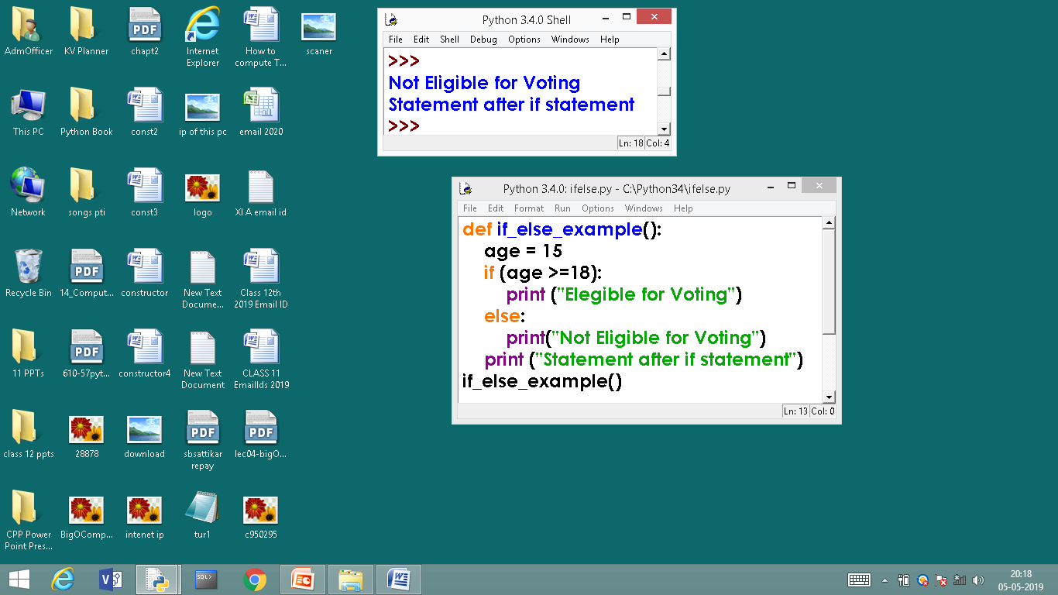
EXAMPLE – if else STATEMENT
: Colon Must
else is used
OUT PUT

Slide 59
CONDITIONAL CONSTRUCT
EXAMPLES – if elif STATEMENT

Slide 60
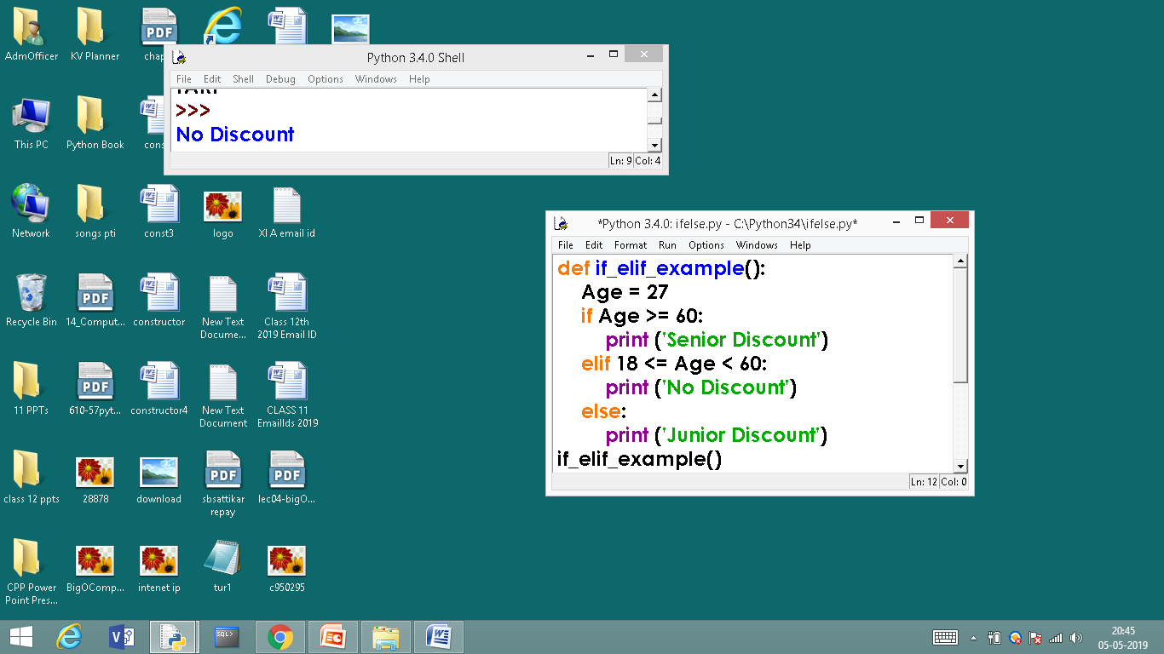
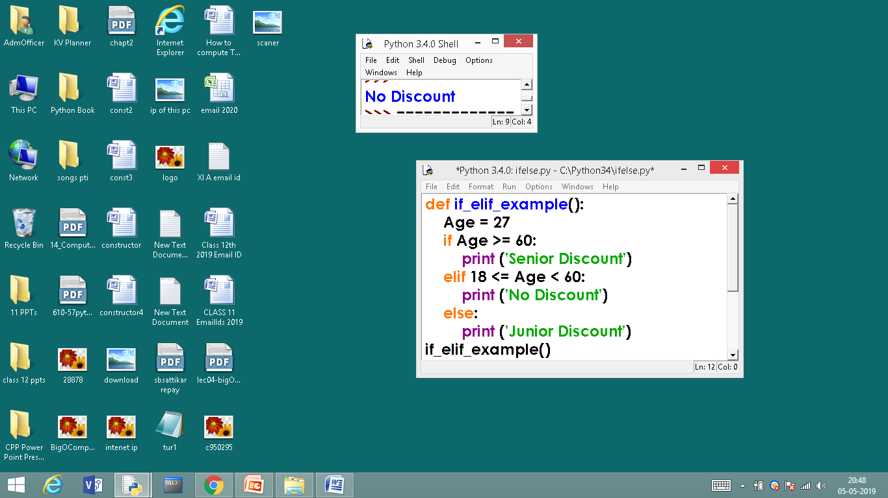
EXAMPLES – if elif STATEMENT
READ AS
18 is less than age
and
18 is less than 60
OUTPUT

Slide 61
PROGRAM LIST ON if CONTSTUCT

Slide 62
PROGRAM LIST ON if CONTSTUCT
BELOW AVERAGE PROGRAMS
1. Write a PYTHON program that reads a value of n and check the number is zero or non zero value.
2. Write a PYTHON program to find a largest of two numbers.
3. Write a PYTHON program that reads the number and check the no is positive or negative.
4. Write a PYTHON program to check entered character is vowel or consonant.

Slide 63
PROGRAM LIST ON if CONTSTUCT
AVERAGE PROGRAMS
5. Write a PYTHON program to evaluate the student performance
If % is >=90 then Excellent performance
If % is >=80 then Very Good performance
If % is >=70 then Good performance
If % is >=60 then average performance
else Poor performance.
6. Write a PYTHON program to find largest of three numbers.
7. Write a PYTHON program to find smallest of three numbers

Slide 64
PROGRAM LIST ON if CONTSTUCT
ABOVE AVERAGE PROGRAMS
8.Write a PYTHON program to check weather number is even or odd.
9.Write a PYTHON program to check a year for leap year.
10. A company insures its drivers in the following cases: - If the driver is married. - If the driver is unmarried, male and above 30 years of age. - If the driver is unmarried, female and above 25 years of age.

Slide 65
PROGRAM LIST ON if CONTSTUCT
ABOVE AVERAGE PROGRAMS
In all the other cases, the driver is not insured. If the marital status, sex and age of the driver are the inputs,
Write a PYTHON program to determine whether the driver is insured or not
***

Slide 66
3. ITERATION OR LOOPING
ITERATION

Slide 67
3. ITERATION OR LOOPING
What is loop or iteration?
Loops can execute a block of code number of times until a certain condition is met.
OR
The iteration statement allows instructions to be executed until a certain condition is to be fulfilled.
The iteration statements are also called as loops or Looping statements.

Slide 68
3. ITERATION OR LOOPING
Python provides two kinds of loops & they are,
while loop
for loop

Slide 69
while loop

Slide 70
while loop
A while loop allows general repetition based upon the repeated testing of a Boolean condition
The syntax for a while loop in Python is as follows:
while condition:
body
Where, loop body contain the single statement or set of statements (compound statement) or an empty statement.
Contd..
: Colon Must

Slide 71
while loop
The loop iterates while the expression evaluates to true, when expression becomes false the loop terminates.
FLOW CHART
while loop

Slide 72
while loop – Programming example

Slide 73
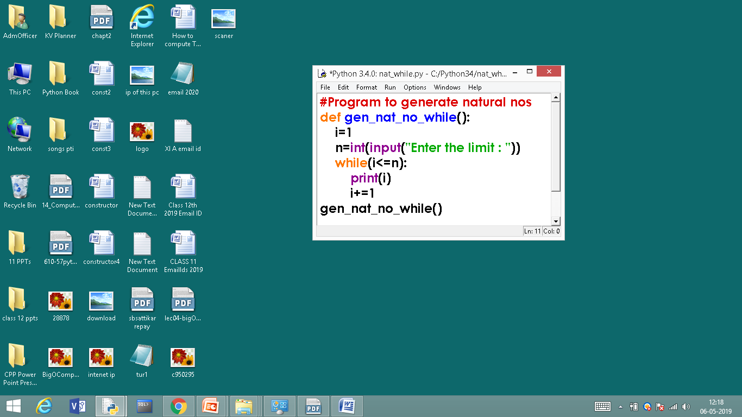
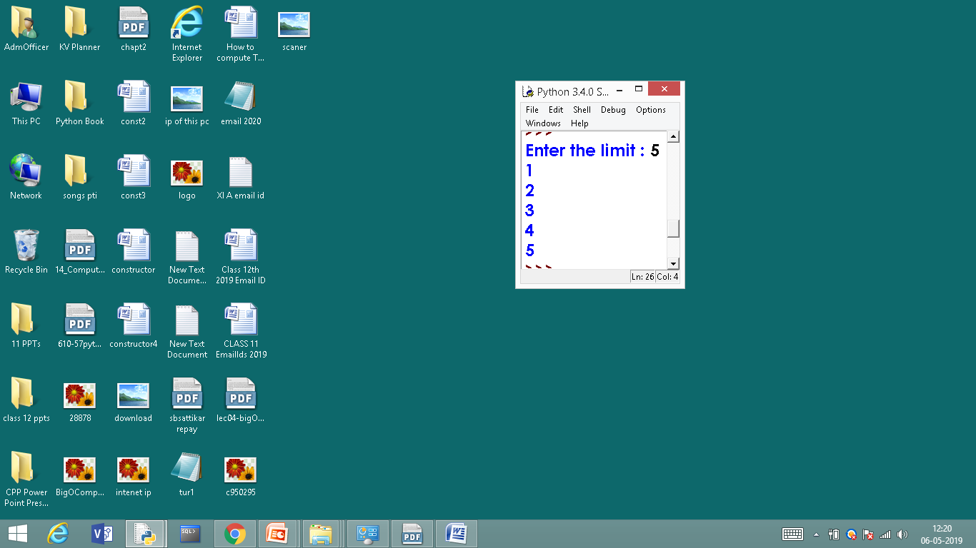
while loop - programs
# Natural Numbers generation
OUTPUT

Slide 74
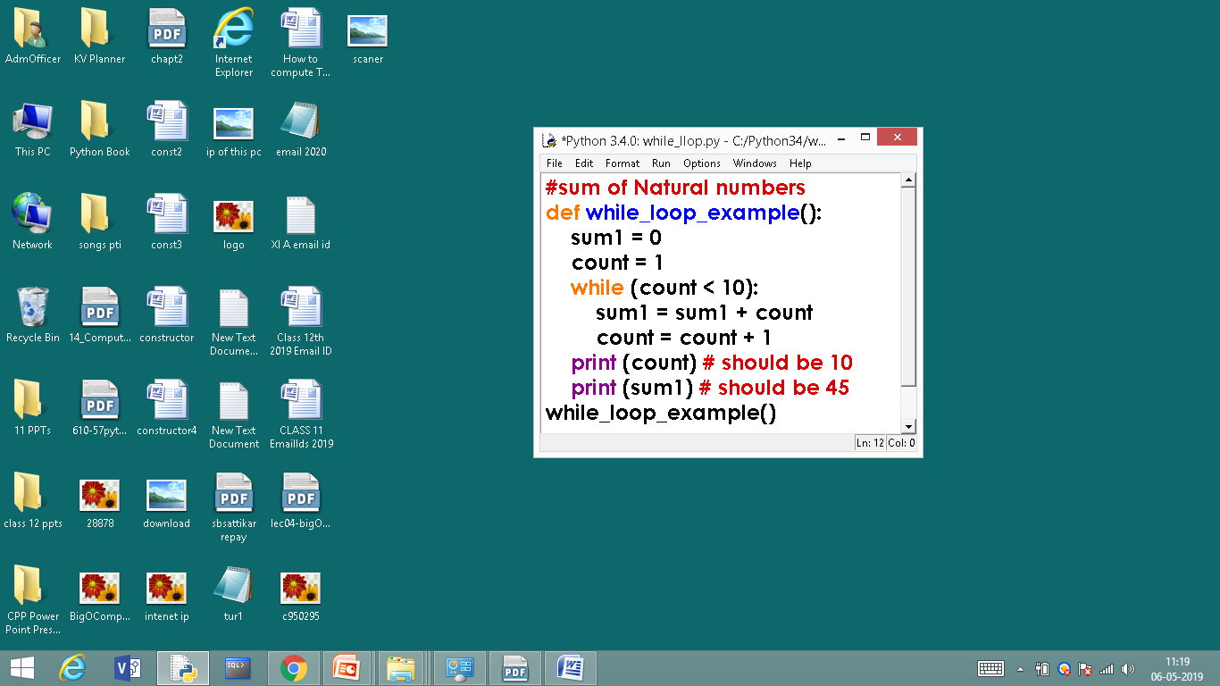
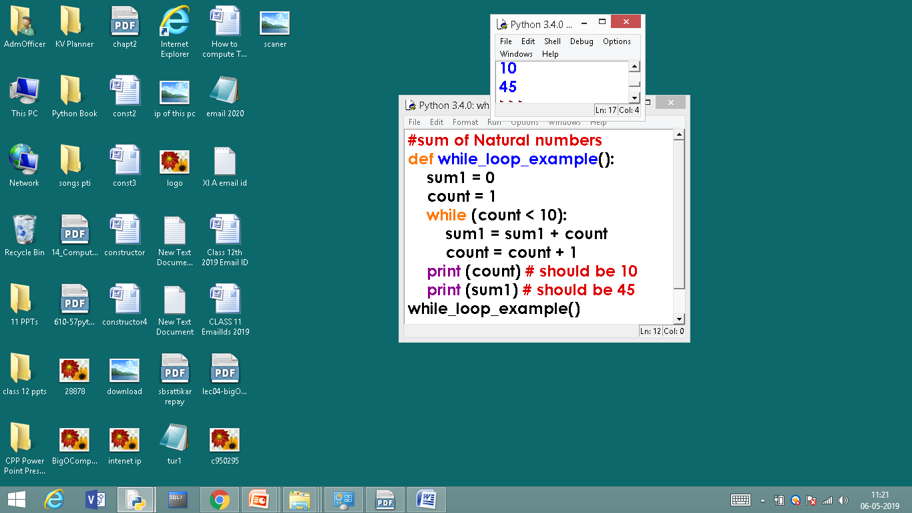
while loop - programs
# Calculating Sum of Natural Numbers
OUTPUT

Slide 75
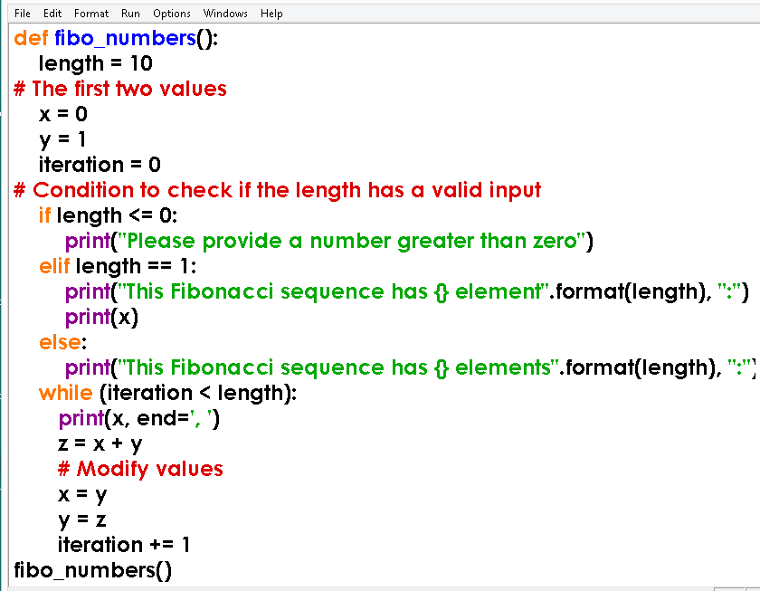
while loop - programs
#Generating Fibonacci numbers

Slide 76
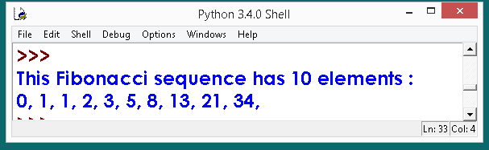
while loop - programs
#Generating Fibonacci numbers
OUTPUT

Slide 77
while loop - Programs
Class work / Home Work

Slide 78
while loop - programs
BELOW AVERAGE PROGRAMS
1. Write a PYTHON program to print the natural numbers up to n
2. Write a PYTHON program to print even numbers up to n
3. Write a PYTHON program to print odd numbers up to n
4. Write a PYTHON program to print sum of natural numbers up to n

Slide 79
while loop - programs
AVERAGE PROGRAMS
5. Write a PYTHON program to print sum of odd numbers up to n
6. Write a PYTHON program to print sum of even numbers up to n
7. Write a PYTHON program to print natural numbers up to n in reverse order.
8. Write a PYTHON program to print Fibonacci series up to n
9. Write a PYTHON program find a factorial of given number

Slide 80
while loop - programs
ABOVE AVERAGE & HOTS PROGRAMS
10. Write a PYTHON program to check the entered number is prime or not
11. Write a PYTHON program to find the sum of digits of given number
12. Write a PYTHON program to check the entered number is palindrome or not
13. Write a PYTHON program to reverse the given number.

Slide 81
while loop - programs
ABOVE AVERAGE & HOTS PROGRAMS
14. Write a PYTHON program to print the multiplication table
15. Write a PYTHON program to print the largest of n numbers
16. Write a PYTHON program to print smallest of n numbers

Slide 82
for LOOP

Slide 83
for LOOP
Python’s for-loop syntax is a more convenient alternative to a while loop when iterating through a series of elements. The for-loop syntax can be used on any type of iterable structure, such as a list, tuple str, set, dict, or file
Syntax or general format of for loop is,
for element in iterable:
body

Slide 84
for LOOP
Python’s for-loop syntax is a more convenient alternative to a while loop when iterating through a series of elements. The for-loop syntax can be used on any type of iterable structure, such as a list, tuple str, set, dict, or file
Syntax or general format of for loop is,
for element in iterable:
body

Slide 85
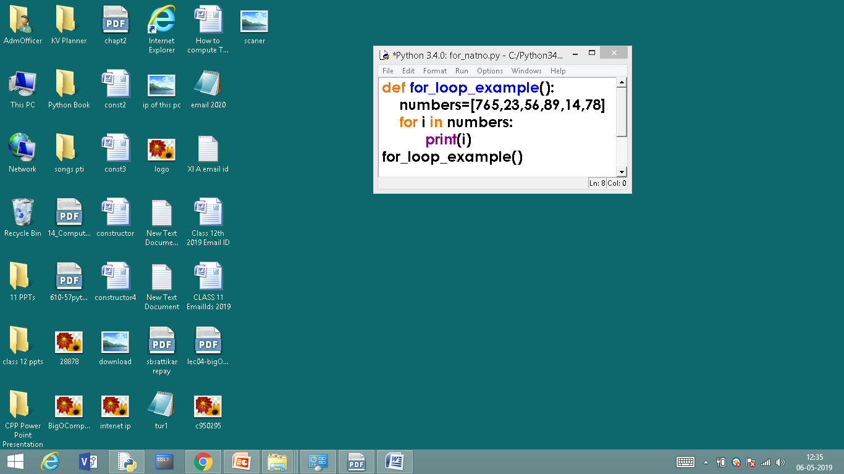
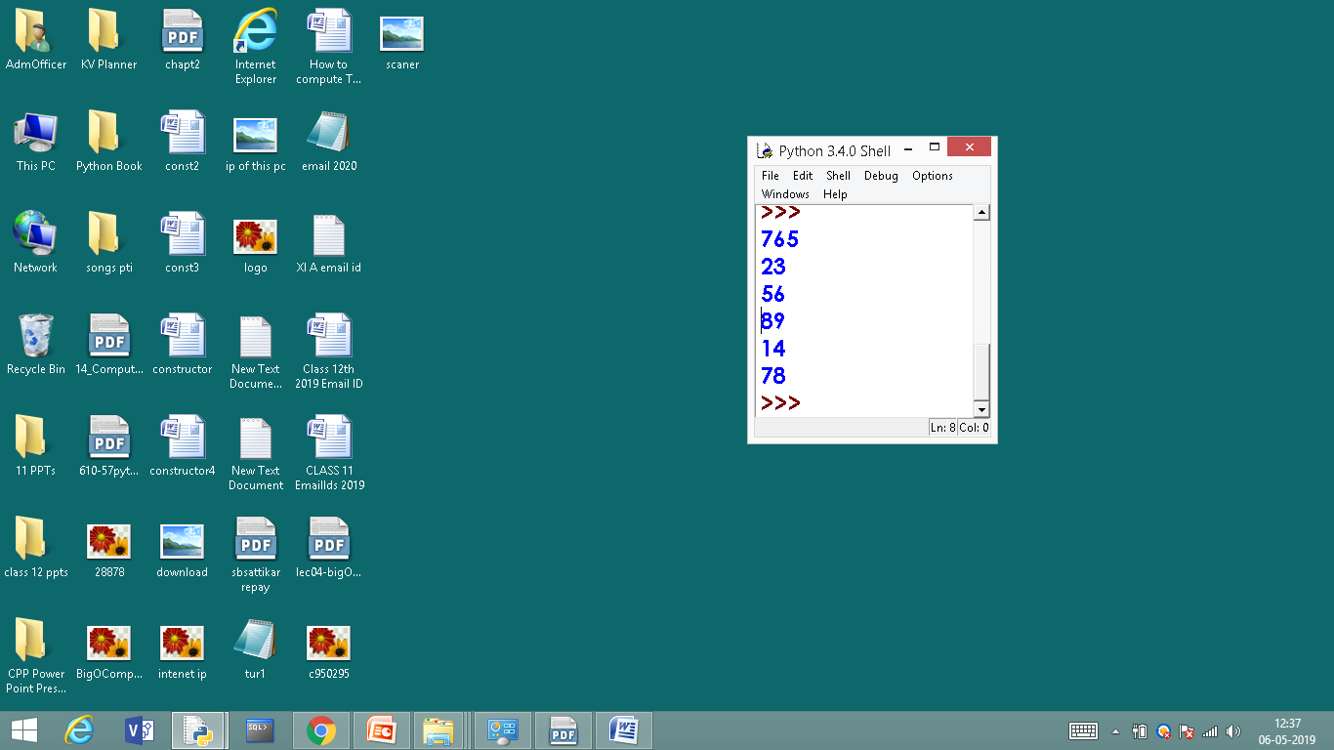
for LOOP
Till the list exhaust for loop will continue to execute.
OUTPUT

Slide 86
for LOOP
range KEYWORD

Slide 87
for LOOP - range KEYWORD
The range() function returns a sequence of numbers, starting from 0 by default, and increments by 1 (by default), and ends at a specified number.
range(start, stop, step)
x = range(3, 6)
for n in x: print(n)
for n in range(3,6): print(n)
OR

Slide 88
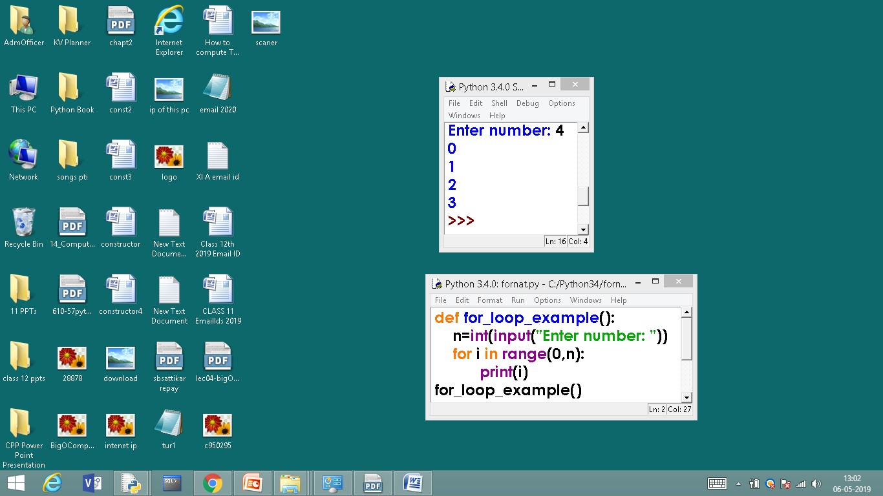
for LOOP - range KEYWORD
#Generating series of numbers
OUTPUT

Slide 89
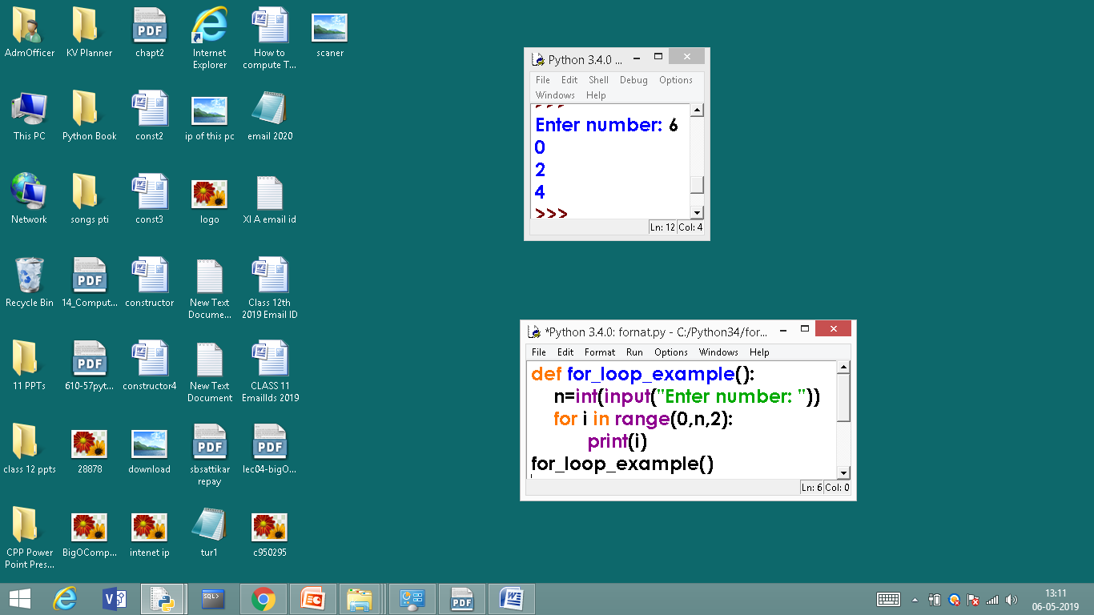

for LOOP - range KEYWORD
#Generating even numbers
OUTPUT

Slide 90
for LOOP – len() FUNCTION

Slide 91
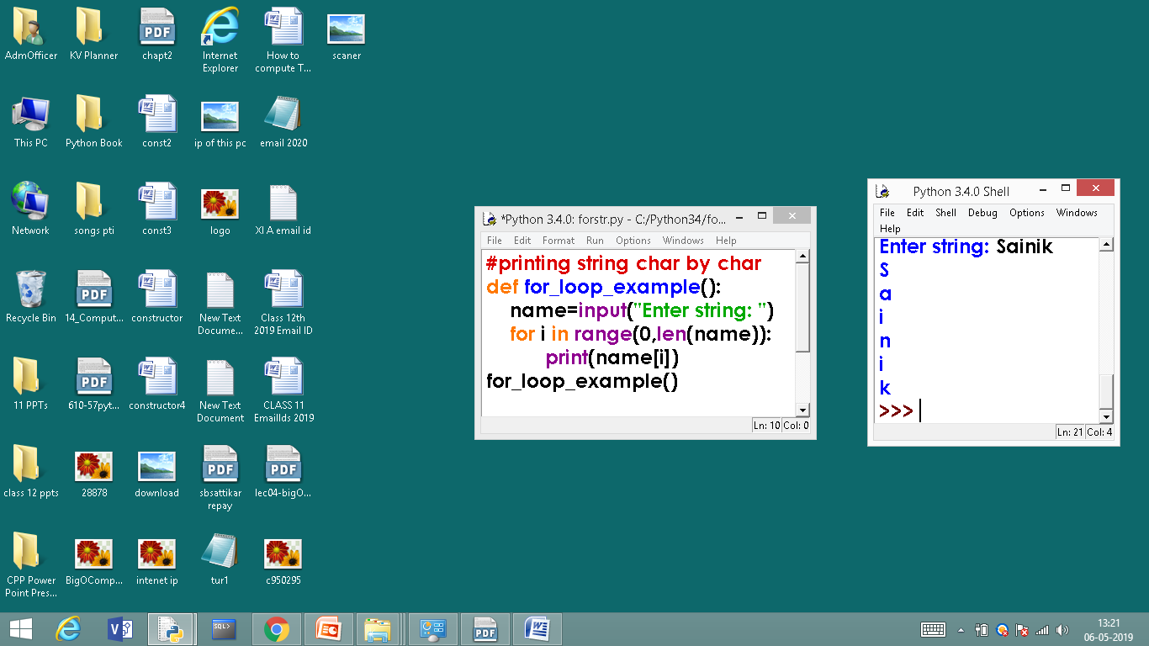
for LOOP - range KEYWORD
# print string character by character
OUTPUT

Slide 92
else statement in loop

Slide 93
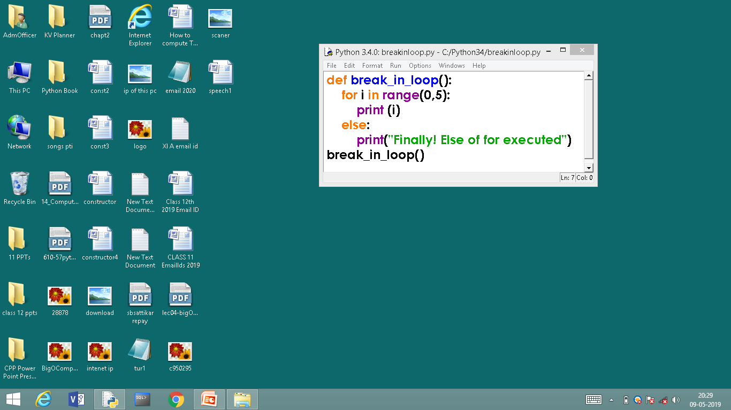
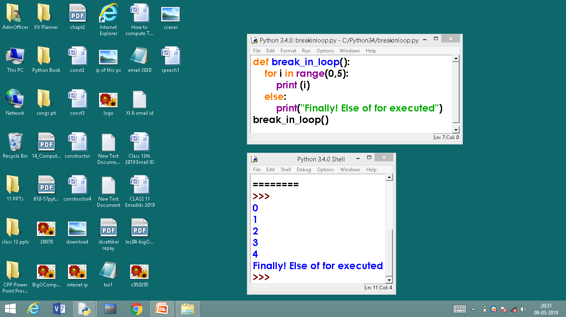
else statement in loop
else can be used in for and while loops the else body will be executed as and when the loop’s conditional expression evaluates to false
OUTPUT

Slide 94
for loop - Programs
Class work / Home Work

Slide 95
for loop – Programs - Class work / Home Work
BELLOW AVERAGE PROGRAMS
1. Write a PYTHON program to print the natural numbers up to n
2. Write a PYTHON program to print even numbers up to n
3. Write a PYTHON program to print odd numbers up to n
4. Write a PYTHON program that prints 1 2 4 8 16 32 … n²
5. Write a PYTHON program to sum the given sequence
1 + 1/ 1! + 1/ 2! + 1/3! + …. + 1/n!

Slide 96
for loop – Programs - Class work / Home Work
AVERAGE PROGRAMS
6. Write a PYTHON program to compute the cosine series
cos(x) = 1 – x² / 2! + x⁴ / 4! – x⁶ / 6! + … x^{n} / n!
7. Write a short PYTHON program to check weather the square root of number is prime or not.
8. Write a PYTHON program to produce following design
A B C
A B C
A B C

Slide 97
for loop – Programs - Class work / Home Work
ABOVE AVERAGE PROGRAMS
9. Write a PYTHON program to produce following design
A
A B
A B C
A B C D
A B C D E
If user enters n value as 5

Slide 98
for loop – Programs - Class work / Home Work
ABOVE AVERAGE PROGRAMS
10. Write a PYTHON program to produce following design
A B C D E
A B C D
A B C
A B
A
(If user enters n value as 5)

Slide 99
for loop – Programs - Class work / Home Work
ABOVE AVERAGE PROGRAMS
11. Write a PYTHON program to produce following design
1
1 2
1 2 3
1 2 3 4
1 2 3 4 5
If user enters n value as 5

Slide 100
for loop – Programs - Class work / Home Work
ABOVE AVERAGE PROGRAMS
12. Write a PYTHON program to produce following design
1
2 2
3 3 3
4 4 4 4
5 5 5 5 5
If user enters n value as 5

Slide 101
4. BRANCHING OR JUMPING STATEMENTS

Slide 102
4. BRANCHING OR JUMPING STATEMENTS
Python has an unconditional branching statements and they are,
1. break STATEMENT
2. continue STATEMENT

Slide 103
4. BRANCHING OR JUMPING STATEMENTS
1. break STATEMENT
Break can be used to unconditionally jump out of the loop. It terminates the execution of the loop. Break can be used in while loop and for loop. Break is mostly required, when because of some external condition, we need to exit from a loop.

Slide 104
1. break STATEMENT
Condition ?
Loop
break causes jump
True
Statement 1
break

Slide 105


1. break STATEMENT
OUT PUT

Slide 106
2. continue STATEMENT
The continue statement in Python returns the control to the beginning of the while loop. The continue statement rejects all the remaining statements in the current iteration of the loop and moves the control back to the top of the loop. The continue statement can be used in both while and for loops.

Slide 107
2. continue STATEMENT
Condition ?
Loop
False
True
Statement 1
Statements ignored or skipped
continue
continue causes jump
Statement n

Slide 108


2. continue STATEMENT
when i value becomes 2 the print statement gets skipped, continue statement goes for next iteration, hence in the out put 2 is not printed

Slide 109
pass STATEMENT

Slide 110
pass STATEMENT
The pass statement in Python is used when a statement is required syntactically but you do not want any command or code to execute.
The pass statement is a null operation; nothing happens when it executes.
The pass is also useful in places where your code will eventually go, but has not been written yet (e.g., in stubs for example):

Slide 111


pass STATEMENT
pass in loop has no output
pass in loop

Slide 112
Difference Between break and continue
break
continue

Slide 113
Difference Between break and continue
BREAK | CONTINUE
It terminates the execution of remaining iteration of the loop. | It terminates only the current iteration of the loop.
'break' resumes the control of the program to the end of loop enclosing that 'break'. | 'continue' resumes the control of the program to the next iteration of that loop enclosing 'continue'.
It causes early termination of loop. | It causes early execution of the next iteration.
'break' stops the continuation of loop. | 'continue' do not stops the continuation of loop, it only stops the current iteration.

Slide 114
CLASS TEST

Slide 115
CLASS TEST
Time: 40 Min Max Marks: 20
Explain the types control structures 05
2. Write a program to check number is prime or not 05
3. Write a program to check the entered number is Armstrong number or not 05
4. Differentiate between break and continue 05

Slide 116
Thank You
Next Video
Array Methods in Python
Subscribe,
like,
comment

